Slide 1
Living Your Best Life: Survivorship, Illness Prevention & Health Maintenance

Slide 2
Agenda
Defining Survivorship
Health Screening
Illness Prevention
Self-Help Strategies
This Photo by Unknown Author is licensed under CC BY

Slide 3
Survivorship & Myeloma
Notes:
NLB Survivorship Care Plan for MM | Int’l Myeloma Fndn

Slide 4
Survivorship Begins At Diagnosis
“Survivor” applies to anyone who has received a diagnosis of cancer
“Survivorship” applies to people actively being treated, those no longer receiving treatment, and people living with end-stage disease
Survivorship “is a state of being” and recognizes that both diagnosis and treatment have lasting impact on survivors in all domains of life:
Physical
Psychological
Social
Economic
NCCN Guidelines Version 1.2024 Survivorship; https://cancercontrol.cancer.gov/ocs/definitions
Notes:
https://www.nccn.org/professionals/physician_gls/pdf/survivorship.pdf
https://cancercontrol.cancer.gov/ocs/definitions

Slide 5
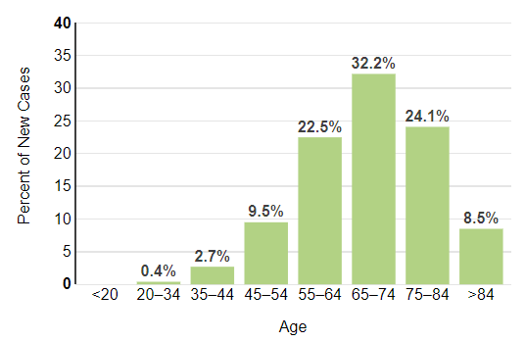
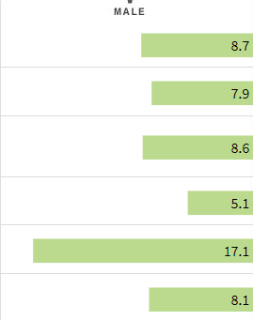
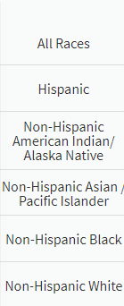
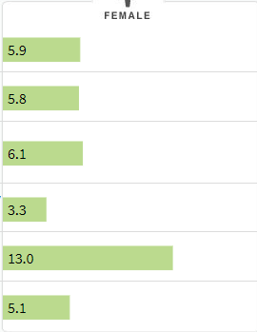
Myeloma Has No Boundaries
Percent of New Cases by Age
Estimated New Cases in 2024 | 35,780
% of All New Cancer Cases | 1.8%
Median Age At Diagnosis | 69 years
https://seer.cancer.gov/statfacts/html/mulmy.html; dated 6.15.2024
Notes:
Predominantly effects:
Non-Hispanic Blacks
Men
People over the age of 60

Slide 6
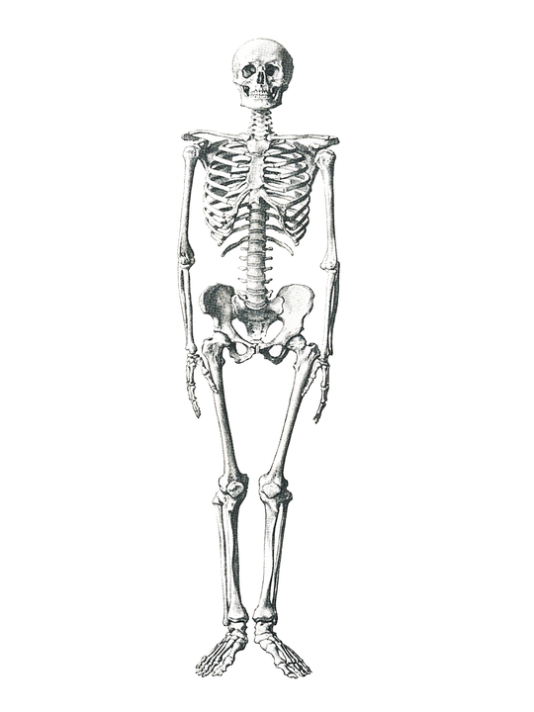
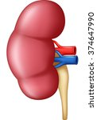
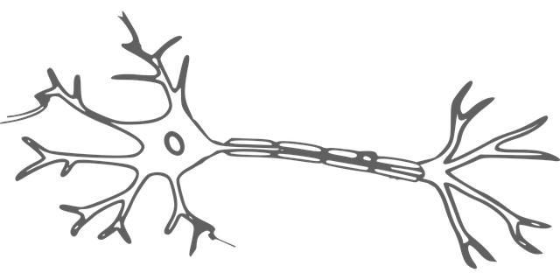
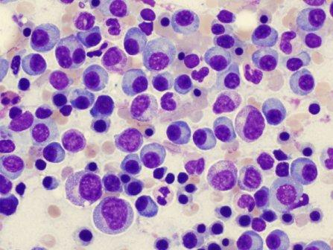
Myeloma Defining Events (MDE) & Treatment Impact Daily Activities
Mobility
Risk of Falling
Infection
Fatigue
Pain
Myeloma causes the highest burden of symptoms, most commonly effecting people of older age with other medical issues.
NCCN Guidelines Version 1.2024 Survivorship
This Photo by Unknown Author is licensed under CC BY-NC-ND
Notes:
Highest burden of symptoms
MM and treatment can lead to co-morbid conditions, inversely other co-morbid conditions can make MM and treatment more challenging

Slide 7
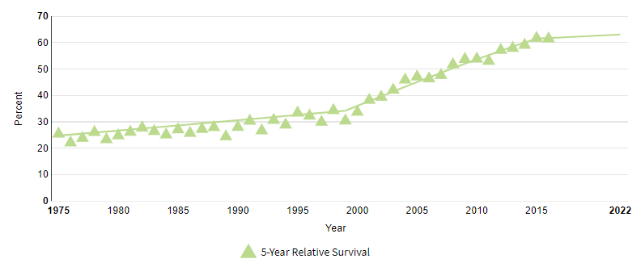
Living Longer, Living Well
5-year Relative Survival | 61.1%
“The 'efficacy' of treatment means different things to different patients, and treatment decision-making in the context of personalized medicine must be guided by an individual's composite definition of what constitutes the best treatment choice.” Terpos, et al., 2021
https://seer.cancer.gov/statfacts/html/mulmy.html; dated 6.15.2024
Notes:
As a result of new therapies, people are living longer with myeloma, but there can be effects related to MM and treatment

Slide 8
Health & Cancer Screening
Notes:
NLB Survivorship Care Plan for MM | Int’l Myeloma Fndn

Slide 9
Late Effects of Treatment
Past and continued treatment can cause new and persistent symptoms. Survivorship focuses on symptoms that happen months to years following treatment and because of treatment. Examples:
Mediastinal radiation (radiation to the chest area) can cause early, advanced coronary artery disease; skin, lung and breast cancer
Long-term steroid use can lead to diabetes, adrenal insufficiency, osteoporosis and cataracts at a younger age
High dose chemotherapy associated with stem cell transplant can lead to early menopause, MDS/AML
Treatment and persistent immunosuppression increases the risk of infection and secondary cancers
It is important for your health care team to be aware of past treatment so proper screening can be done (a.k.a. Care Planning)
NCCN://efaidnbmnnnibpcajpcglclefindmkaj/https://www.nccn.org/professionals/physician_gls/pdf/survivorship.pdf
Notes:
https://www.nccn.org/professionals/physician_gls/pdf/survivorship.pdf

Slide 10
Know the members of your care team
Understand their different roles
Allied Health Staff
Primary Care Provider (PCP)
Family/Support Network
You & Your Care Partner
Subspecialists
General Hem/Onc
Myeloma Specialist
Does your clinic have a “Survivorship Clinic”?
Notes:
Who do you list as members of your HC team?
The first 3 are likely pretty easy – PCP, General Hem/Onc, maybe a MM specialist (I hope a MM specialist)
But who else?
Maybe you see a subspecialist – kidney or bone doctor? Endocrinologist?
Your nurses, pharmacist, social worker
What about your family, friends, spiritual family?
Don’t forget to include you and your care partner who are central to this team.

Slide 11
General Health Screening Recommendations*
Health screening serves the purpose to identify a disease early that may not show symptoms but can cause significant disease, that has an available treatment, and is more common in certain populations or age groups.
*Standard screening recommendations. Recommendations may be modified to meet individual needs.
Endocrine:
Osteoporosis
Thyroid: Thyroid Stimulating Hormone (TSH)
Hyperglycemia/Diabetes
Cardiac:
Blood pressure
Cholesterol
Hepatitis C Virus: adults aged 18 to 79 years
Oral and Dental Screening
Eye/Vision Screening
Screening for People at Risk:
Fall Prevention
HIV: adults aged 15 to 65 years
Tuberculosis: populations at increased risk
Primary Care Provider (PCP)
Subspecialists
Givler DN, Givler A. Health Screening. [Updated 2023 Feb 19]. In: StatPearls [Internet]. Treasure Island (FL): StatPearls Publishing; 2024 Jan-. Available from: https://www.ncbi.nlm.nih.gov/books/NBK436014/
Notes:
Givler DN, Givler A. Health Screening. [Updated 2023 Feb 19]. In: StatPearls [Internet]. Treasure Island (FL): StatPearls Publishing; 2024 Jan-. Available from: https://www.ncbi.nlm.nih.gov/books/NBK436014/

Slide 12
Cancer Screening Recommendations*
Continued surveillance for recurrence/progression of myeloma and screening for other primary cancers.
Primary Care Provider (PCP)
Skin: Dermatologic evaluation annually or as indicated
Thyroid cancer or dysfunction: Thyroid Stimulating Hormone (TSH)
Lung: Begin age 50 years, then annual LD-CT for people with a history of smoking at least 20 pack/years, and former smokers who quit within the previous 15 years.
Colorectal: Begin age 50, younger if high risk; rescreen every 3-10 years based on type of test and risk profile
Women (assigned female at birth): Cervical and Breast Cancer Screening
Cervical screening begins as early as age 21 years, every 3-5 years until age 65 years
Breast screening begins at age 40 years, then every other year until age 74 years
Men (assigned male at birth): Prostate Cancer Screening (PSA) may begin at age 55 years then every 2-4 years; not recommended beyond age 70 years.
*Standard screening recommendations. Recommendations may be adjusted to meet individual needs.
NCCN = National Comprehensive Cancer Network
USPSTF = United States Preventive Services Task Force
ACS = American Cancer Society
Givler DN, Givler A. Health Screening. [Updated 2023 Feb 19]. In: StatPearls [Internet]. Treasure Island (FL): StatPearls Publishing; 2024 Jan-. Available from: https://www.ncbi.nlm.nih.gov/books/NBK436014/
Notes:
5149 Characteristics and Outcomes of Patients with Second Hematological Malignancies after Autologous Hematopoietic Cell Transplantation for Multiple Myeloma
Binoy Yohannan, MD^{1,2}, Angela Dispenzieri, MD¹, Francis Buadi, MD¹, David Dingli, MD, PhD¹, Nelson Leung, MD¹, Prashant Kapoor, MD³, Wilson I. Gonsalves, MD⁴, Taxiarchis Kourelis, MD¹, Joselle Cook, MBBS¹, Moritz Binder, MD¹, Suzanne R Hayman, MD¹, Yi Lin, MD, PhD¹, Ronald S Go, M.D.¹, Rahma M Warsame, MD¹, Vincent Rajkumar, MD^{1*}, Shaji Kumar, MD¹, Eli Muchtar, MD¹, Hassan B Alkhateeb, MD^{1*}, William J. Hogan, MD¹, Mark R. Litzow, MD¹, Mrinal M. Patnaik, MD, MBBS³, Aref Al-Kali, MD¹, Abhishek Mangaonkar, MD^{5*}, Robert C Wolf, Pharm.D, R.Ph.^{6*}, Mithun V Shah, M.D., Ph.D.¹ and Morie A. Gertz, MD¹
https://ash.confex.com/ash/2024/webprogram/Paper210932.html

Slide 13
Focus on Myeloma Related Screening
Treatment for myeloma can increase the chances of having other health issues.
Primary Care Provider (PCP)
Cancer:
Skin: Dermatologic evaluation annually or as indicated
Secondary Solid Tumor Malignancy
Secondary Myelodysplastic Syndrome (MDS)/Leukemia
Immune Incompetence:
IgG (hypogammaglobulinemia)
CD3+ T-Cell Count
Absolute Neutrophil Count (ANC)
Frequent intervention for recurrent infections
Endocrine:
Thyroid dysfunction: Thyroid Stimulating Hormone (TSH)
Adrenal Insufficiency: Cortisol
Hyperglycemia/Diabetes: Glucose, HgbA1C
Osteoporosis: DEXA scan (less likely if taking bone strengthening treatment)
Infertility and pre-mature menopause
Dental: prudent dental care, scheduled cleanings
Cardiovascular:
Blood pressure monitoring
ECG
Echocardiogram if indicated
https://onlinelibrary.wiley.com/doi/epdf/10.1002/ccr3.2362; https://www.medicalnewstoday.com/articles/drugs-revlimid-side-effects
Myeloma Specialist
General Hem/Onc
Notes:
lenalidomide can cause thyroid dysfunction. It has been reported to cause both hypothyroidism (underactive thyroid) and hyperthyroidism (overactive thyroid) in some patients¹². These thyroid abnormalities occur in approximately 5% to 10% of patients treated with lenalidomide³.
If you or someone you know is experiencing symptoms of thyroid dysfunction while taking lenalidomide, it’s important to consult with a healthcare provider for proper evaluation and management.
https://onlinelibrary.wiley.com/doi/epdf/10.1002/ccr3.2362
https://www.medicalnewstoday.com/articles/drugs-revlimid-side-effects
https://www.cancer.org/cancer/types/multiple-myeloma/after-treatment/follow-up.html

Slide 14
Mental Health Screening
What will happen to my family? Are they at risk, too?
Cancer survivors are at increased risk of anxiety, fear and depression.
How/Why did this happen?
Will I be able to keep my job and afford my treatment?
Will the tests show my cancer is back?
How can I plan for the future?
Will the treatment work?
Will I have pain?
NCCN.org
Notes:
https://lymphoma.org/wp-content/uploads/2022/05/LRF-Survivorship-Fact-Sheet-When-Treatment-is-Over-042222.pdf
Survivorship issues can also include psychological effects like anxiety, depression, and post-traumatic stress disorder (PTSD),

Slide 15
Mental Health Support
Asking for psychological support is no different than seeking medical support.
Support Groups: https://www.myeloma.org/support-groups
Myeloma specific
Specialty groups
Community Resources:
Build a social network
Spiritual community
Professional Counseling
Individual
Family
Couples
Medical Intervention:
Medications
Non-Medical Interventions:
Meditation
Mind-Body Connection
Physical activity
Diet modification
Sleep hygiene
Notes:
https://lymphoma.org/wp-content/uploads/2022/05/LRF-Survivorship-Fact-Sheet-When-Treatment-is-Over-042222.pdf
Survivorship issues can also include psychological effects like anxiety, depression, and post-traumatic stress disorder (PTSD),
https://www.cancersupportcommunity.org/cancer-support-helpline

Slide 16
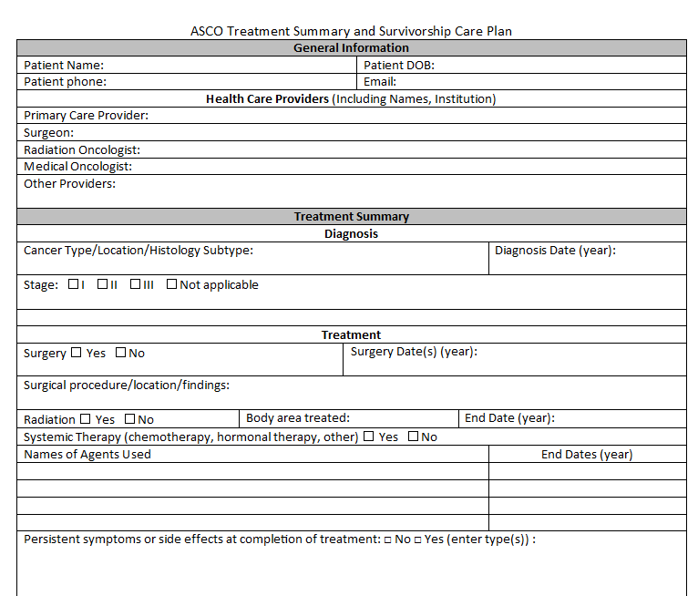
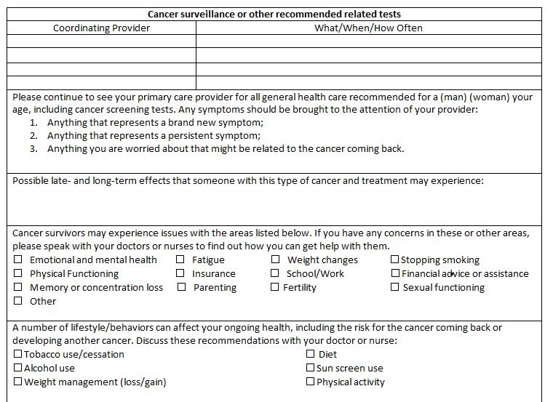
Survivorship Care Plan
asco-treatment-summary-and-survivorship-care-plan.docx (live.com); NLB Survivorship Care Plan for MM | Int’l Myeloma Fndn
Notes:
asco-treatment-summary-and-survivorship-care-plan.docx (live.com)
IMF Nurse Leadership Board (NLB) Survivorship Care Plan for Multiple Myeloma NLB Survivorship Care Plan for MM | Int’l Myeloma Fndn

Slide 17
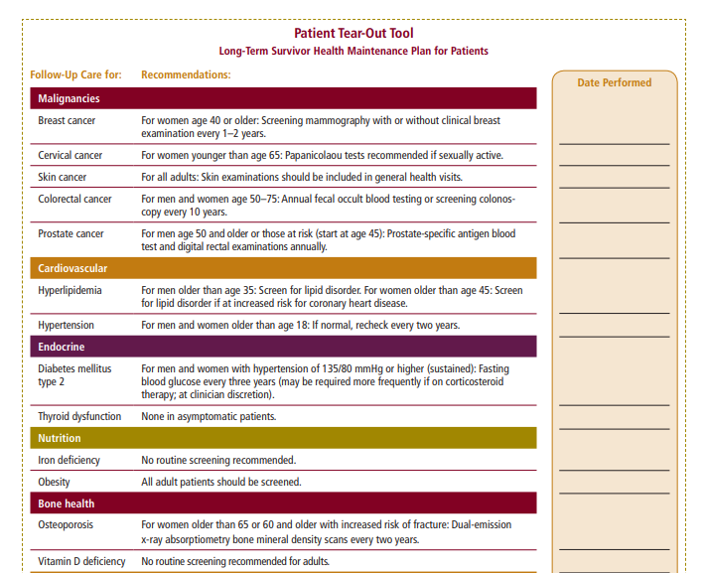
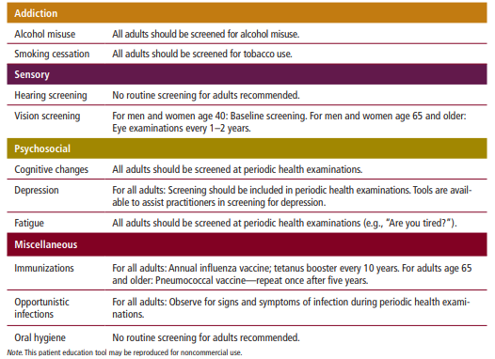
Survivorship Care Plan
NLB Survivorship Care Plan for MM | Int’l Myeloma Fndn
Notes:
asco-treatment-summary-and-survivorship-care-plan.docx (live.com)
IMF Nurse Leadership Board (NLB) Survivorship Care Plan for Multiple Myeloma NLB Survivorship Care Plan for MM | Int’l Myeloma Fndn

Slide 18
Illness Prevention Wellness Strategies
Notes:
NLB Survivorship Care Plan for MM | Int’l Myeloma Fndn

Slide 19
Wellness Strategies: Infection Prevention
Infection is a significant risk for people with myeloma. Active myeloma and myeloma therapy increase the risk for infection
Preventative antibiotics
IVIG supplement infusion
Vaccines
Personal hygiene
Environmental control
Type of Infection Risk | Medication Recommendation(s) for Healthcare Team Consideration
Viral: Herpes Simplex (HSV/VZV); CMV | Acyclovir prophylaxis
Bacterial: blood, pneumonia, and urinary tract infection | Consider prophylaxis with levofloxacin
PJP (P. jirovecii pneumonia) | Consider prophylaxis with trimethoprim-sulfamethoxazole
Fungal infections | Consider prophylaxis with fluconazole
COVID-19 and Influenza | Antiviral therapy if exposed or positive for covid per institution recommendations
IgG < 400 mg/dL (general infection risk) | IVIg recommended
ANC < 1000 cells/μL (general infection risk) | Consider GCSF 2 or 3 times/wk (or as frequently as needed) to maintain ANC > 1000 cells/μL and maintain treatment dose intensity
Notes:
https://www.uspreventiveservicestaskforce.org/uspstf/recommendation-topics/uspstf-a-and-b-recommendations#bcf
Abdominal Aortic Aneurysm: Screening: men aged 65 to 75 years who have ever smoked
Depression and Suicide Risk in Adults: Sc
Falls Prevention in Community-Dwelling Older Adults: Interventions: adults 65 years or olderreening: adults, including pregnant and postpartum persons, and older adults (65 years or older)
Hepatitis C Virus Infection in Adolescents and Adults: Screening: adults aged 18 to 79 years
Prevention of Acquisition of HIV: Preexposure Prophylaxis: adolescents and adults at increased risk of hiv
Human Immunodeficiency Virus (HIV) Infection: Screening: adolescents and adults aged 15 to 65 years
Sexually Transmitted Infections: Behavioral Counseling: sexually active adolescents and adults at increased risk
Hypertension in Adults: Screening: adults 18 years or older without known hypertension
Osteoporosis to Prevent Fractures: Screening: women 65 years and older
Prediabetes and Type 2 Diabetes: Screening: asymptomatic adults aged 35 to 70 years who have overweight or obesity
Statin Use for the Primary Prevention of Cardiovascular Disease in Adults: Preventive Medication: adults aged 40 to 75 years who have 1 or more cardiovascular risk factors and an estimated 10-year cardiovascular disease (cvd) risk of 10% or greater
Tobacco Smoking Cessation in Adults, Including Pregnant Persons: Interventions: pregnant persons
Unhealthy Alcohol Use in Adolescents and Adults: Screening and Behavioral Counseling Interventions: adults 18 years or older, including pregnant women
Unhealthy Drug Use: Screening: adults age 18 years or older
Weight Loss to Prevent Obesity-Related Morbidity and Mortality in Adults: Behavioral Interventions: adults

Slide 20
Wellness Strategies: Facilitating Care
Maintain a Health Record
Know Your Health Care Team Members
Undergo Health Screening
Report Symptoms
Consider Your Preferences & Priorities
Stay informed
Share with care partners
Prepare Advanced Care Planning documents
Create/Maintain a Social Network
Rod NH et al 2014. PloS one. 9(4):e91965; Coleman et al. 2011. Cancer Nurs. 34(3):219-227.National Sleep Foundation. At: http://sleepfoundation.org/ask-the-expert/sleep-hygiene
Mustian et al. Journal of clinical Oncology. Sep 10 2013;31(26):3233-3241; Stan DL, et al. Clin J Oncol Nurs. Apr 2012;16(2):131-141; Zeng Y et al., Complementary therapies in medicine. Feb 2014;22(1):173-186.
Notes:
3771 Survivorship Burden and Patient Preferences Affecting Treatment Choices Among Multiple Myeloma (MM) Patients: Real-World Learnings from a Large, Prospective Study
Jayla Mondy^{1*}, Saurav Das, MD^{2*}, Dhaani Ailawadhi^{3*}, Yaw Adu^{4*} and Sikander Ailawadhi⁵
https://ash.confex.com/ash/2024/webprogram/Paper209052.html

Slide 21
Wellness Strategies: Lifestyle
Adopt Healthful Lifestyle
Stress Management
Physical activity & strengthening
Mental activity & strengthening
Quit smoking, limit alcohol
Sleep hygiene for improved sleep quality
Healthful, plant-based diet
Weight management
Maintain Renal and Bone Health
Rod NH et al 2014. PloS one. 9(4):e91965; Coleman et al. 2011. Cancer Nurs. 34(3):219-227.National Sleep Foundation. At: http://sleepfoundation.org/ask-the-expert/sleep-hygiene
Mustian et al. Journal of clinical Oncology. Sep 10 2013;31(26):3233-3241; Stan DL, et al. Clin J Oncol Nurs. Apr 2012;16(2):131-141; Zeng Y et al., Complementary therapies in medicine. Feb 2014;22(1):173-186.

Slide 22
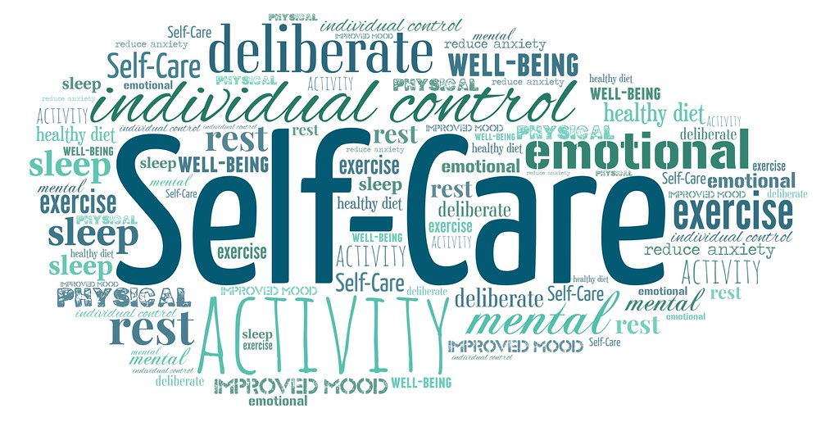
Wellness Strategies: Apply to Care Partners
Maintain a Health Record
Know Your Health Care Team Members
Undergo Health Screening
Report Symptoms
Consider Your Preferences & Priorities
Prepare Advanced Care Planning documents
Create/Maintain a Social Network
Adopt Healthful Lifestyle
Stress Management
Physical activity & strengthening
Mental activity & strengthening
Quit smoking, limit alcohol
Sleep hygiene for improved sleep quality
Healthful, plant-based diet
Weight management
This Photo by Unknown Author is licensed under CC BY
Rod NH et al 2014. PloS one. 9(4):e91965; Coleman et al. 2011. Cancer Nurs. 34(3):219-227.National Sleep Foundation. At: http://sleepfoundation.org/ask-the-expert/sleep-hygiene
Mustian et al. Journal of clinical Oncology. Sep 10 2013;31(26):3233-3241; Stan DL, et al. Clin J Oncol Nurs. Apr 2012;16(2):131-141; Zeng Y et al., Complementary therapies in medicine. Feb 2014;22(1):173-186.

Slide 23
Key Take-Aways
Myeloma affects people of all ages, color, physical ability, socio-economic status and gender
People are living longer with myeloma
Side effects of myeloma & therapy affect people differently
Quality of Life means something different to each person
Incorporating a Survivorship Care Plan is important for enhancing quality of life while managing myeloma
Survivorship Care Plans are important for care partners
Myeloma Management continues to be a “Team” activity. You and your Primary Care Provider are an integral part of that team.
NCCN Guidelines Version 1.2024 Survivorship
Notes:
https://www.nccn.org/professionals/physician_gls/pdf/survivorship.pdf

Slide 24
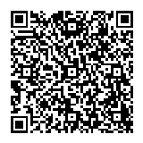
Thank you for completing the Pre-Survey. Please scan to complete the Post Survey. Link also in the chat box

Slide 25
Living Well with Smoldering Myeloma
Physical Health
Strengthen your body
Spiritual Health
Embrace your personal philosophy
Social Health
Develop a social network
Emotional Health
Be present in the moment; reframe to the positive
This Photo by Unknown Author is licensed under CC BY-SA-NC

