Slide 1
Lab Results: What are they and why do we care?
Colleen H. Erb, MSN, CRNP ACNP-BC, AOCNP
Hematology/Oncology Nurse Practitioner
Jefferson Health – Asplundh Cancer Pavilion

Slide 2
Important things to remember
ALWAYS ASK YOUR PROVIDER – I can’t go over individual results or individualized cases today.
DO NOT COMPARE YOUR RESULTS WITH ANYONE ELSE
There will be changes in your results over time
There will be changes that are consistent with normal variation
Knowledge is a great thing! (ask questions)
There is so much more to Myeloma than the numbers!

Slide 3
Important blood work – routine
CBC – including WBC, RBC, Hemoglobin/Hematocrit, Platelets
CMP – including BUN, creatinine, total protein, calcium, albumin
Serum protein electrophoresis
Serum immunofixation
Immunoglobulins
Serum free light chains
At diagnosis: Beta-2 macroglobulin and LDH

Slide 4
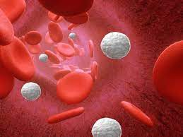
Complete Blood Count (CBC)
This test gives the values of all the cells that make up the blood.
All these cells start out in the bone marrow, but so does myeloma.
Myeloma itself along with most treatments can affect these blood counts.
Monitored closely.
Includes:
Red blood cells
Hemoglobin
Hematocrit
White blood cells
White blood cell differential
Platelets

Slide 5
Red Blood Cells
All have normal ranges that are different for
men and women.
RBC normal is:
4.3 – 5.7 for men
3.9 – 5 for women
These are almost always the first to decrease in number in response to the overproduction of myeloma cells in your bone marrow
Life span is about 28 days

Slide 6
Hemoglobin
This is the most important part of the red blood cell
Transports oxygen throughout the body
Used more frequently than the total red blood cell count when evaluating disease or treatment effects.
Low hemoglobin levels are defined as anemia and are part of the CRAB criteria that defines active myeloma
Normal ranges:
13.5 – 17.5 m/dL for men
12 – 15.5 m/dL for women

Slide 7
Hematocrit
This tells us the volume of red blood cells present in the whole blood.
Expressed as a percentage
Used in conjunction with the red blood cells and hemoglobin to diagnose anemia.
Normal values:
About 45% for men
About 40% for women

Slide 8
White blood cells (WBC)
The white blood cells make up your immune system; they fight off bacteria, viruses, and other toxins.
Low WBC counts can result from disease in the bone marrow or from many of the treatments given for myeloma.
Decreases your ability to fight disease
Life span is 7-14 days
Normal range:
3.5 – 11 x 10^9/L

Slide 9
The WBC differential - neutrophils
Also known as your ANC (absolute neutrophil count)
This is the type of WBC that has the most impact on fighting off disease, particularly those caused by bacteria and fungus.
Low neutrophil count is called neutropenia and can be dangerous.
This will be checked before treatment to make sure it’s safe to continue with therapy that day.
Normal range:
1.7 – 7 x 10^9/L (we usually use less than 1 for decision making)

Slide 10
Platelets
The blood cells that help your blood clot and prevent bleeding.
Low platelets can occur at diagnosis (less commonly than anemia) and can definitely be a result of treatment
Proteasome inhibitors (Carfilzomib, Bortezomib, Ixazomib) are known to cause low platelets.
Selinexor is known to cause low platelets.
Life span in about 11 days
Normal range:
150-450 x 10^9/L (we don’t really hold treatment unless <50 and we don’t worry unless they are <20).

Slide 11
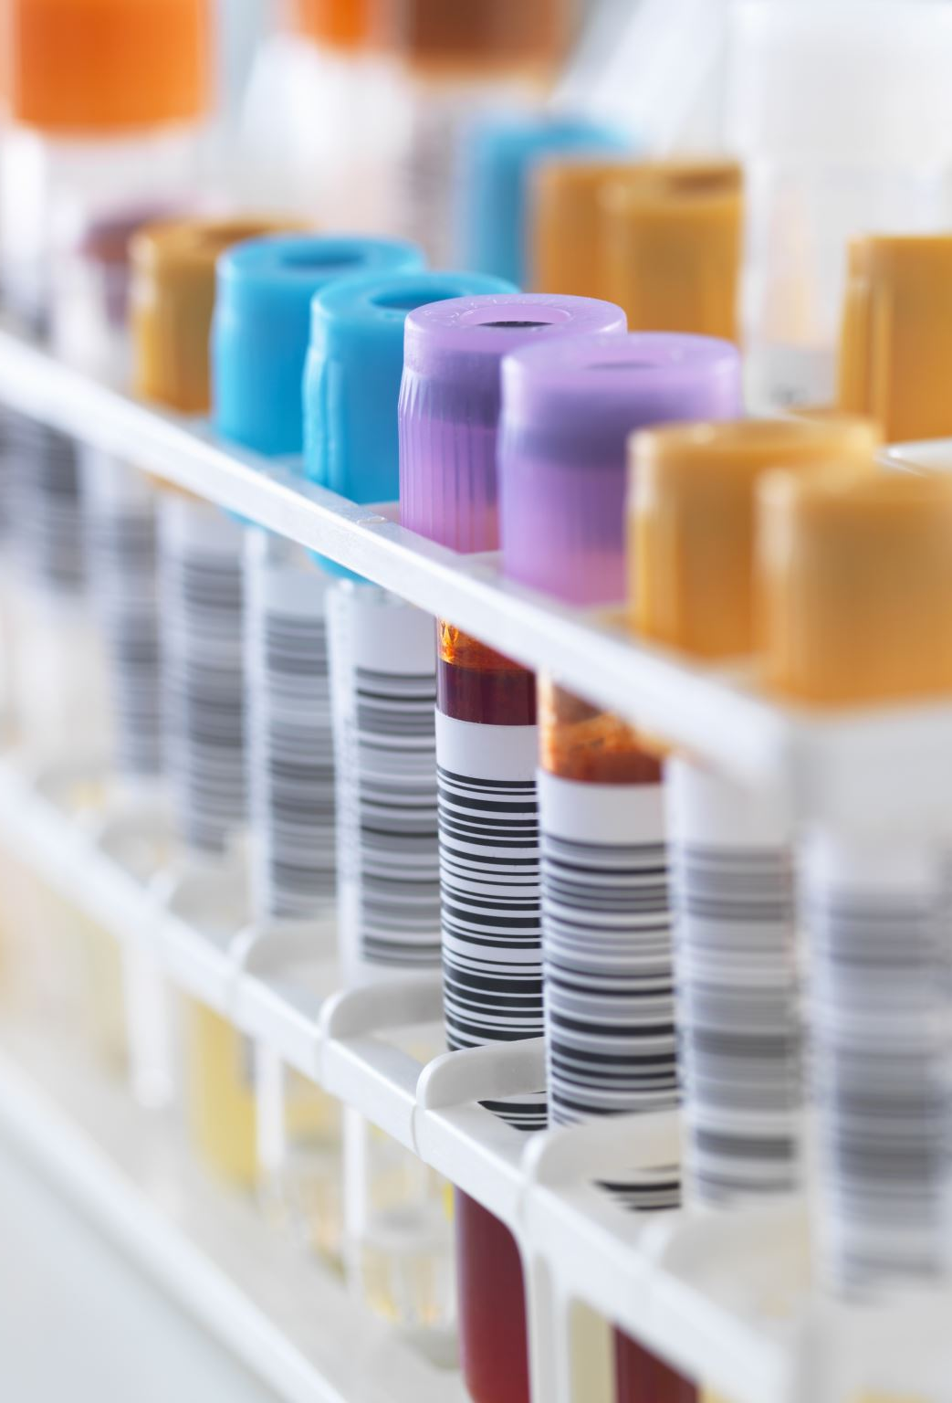
Complete Metabolic Panel (CMP) - chemistry
This test measures a few substances in the blood that are important in myeloma and in measuring the function of your organs.
Along with the CBC, this is a routine test drawn with each visit for treatment or office visit.
Measures that are important in myeloma:
BUN (blood urea nitrogen)
Creatinine
Creatinine clearance and glomerular filtration rate (GFR)
Calcium
Total protein

Slide 12
BUN and Creatinine
These both measure how well your kidneys are functioning
Creatinine is used to measure the “R” in CRAB criteria.
Creatinine is a waste product from normal breakdown and is filtered through the kidneys, excreted by urine.
Serum creatinine level is an important measure of who well your kidneys are filtering
Normal 0.6 -1.3 mg/dL
BUN can be affected by other issues – not just your kidney function itself
Normal is 7-20 mg/dL
Notes:
Kidney function (and therefore creatinine) can be seriously affected by the level of light chain proteins which also have to be filtered by the kidneys.
Should be measured at regular intervals – with each visit and each treatment; particularly if you have protein in the urine
Can also be increased when there is high calcium levels in the blood from myeloma-induced bone breakdown.

Slide 13
Creatinine clearance
The amount of blood per minute that the kidneys can make creatinine-free.
Ideally measured with a 24-hour urine collection and blood sample of the serum creatinine.
Declines normally with age (hence the large range for normal values).
Creatinine clearance less than 40mL/min is considered a myeloma defining event (MDE) – a sign of early active myeloma in people who have no other CRAB criteria.
Normal ranges:
Men: 97-137 mL/min
Women: 88-128 mL/min
Notes:
MDE – patients with these events should be treated rather than watched expectantly.
Other MDE –
Calcium level more than 1mg/dL over the upper limit of normal (~11)
Anemia: Hgb <10 or more than 2g/dL below the lower limit of normal
Bone lesions: more than one osteolytic lesion on skeletal xray, CT, or PET-CT/MRI
Clonal plasma cells >60% in the bone marrow
AND/OR involved/uninvolved SFLC ratio of >100 or <0.01 (lambda)
And/OR one or more bone lesion that is >5mm on MRI

Slide 14
Estimated Glomerular Filtration Rate (eGFR)
Used with the creatinine and creatinine clearance to detect kidney damage.
Estimated because it uses only the blood, not blood and urine to calculate the number.
NOT accurate in those who are over age 70, very overweight, very muscular, or pregnant because it can’t factor in differences caused by those conditions.
Normal:
90-120 (>60 in most labs)

Slide 15
Calcium
The “C” in CRAB criteria is elevated blood calcium level.
Caused by the increased bone breakdown in myeloma – leading to the high blood level of calcium and the increased risk of fracture.
High levels can damage the kidneys.
Normal:
8.9 – 10.5mg/dL
Notes:
Calcium is released into the blood normally through the normal bone remodeling, the breakdown and rebuilding of bone.
Myeloma changes the bone marrow environment and causes a cascade of cellular events that leads to increased breakdown.

Slide 16
Total protein
Measures the total amount of blood protein, including albumin and globulin.
If there is active myeloma present, the level of globulin will be increased which will increase the total.
If seen on a regular exam, an elevated total protein should prompt further testing.
You can get an idea of the breakdown on a CMP because the albumin will also be measured.
Normal:
6-8g/dL

Slide 17
Tests that assess monoclonal protein aka: Your “myeloma” labs

Slide 18
How do I know what’s important? How do I keep track of everything?
Ask your provider – they can give you a lot of insight into which labs are important for your myeloma.
1
Use a handy tip sheet:
2
https://www.myelomacrowd.org/wp-content/uploads/2018/05/Deciphering-My-Myeloma-Lab-Results-V2.pdf
Keep track using a tracking sheet:
3
https://www.patientresource.com/MMTestTracker.pdf (for those who like paper)
https://www.myelomacrowd.org/healthtree-webinar-track-my-myeloma/ (for the tech-inclined)

Slide 19
Serum quantitative immunoglobulins (QIg)
Measures IgA, IgG, IgM – the most commonly affected immunoglobulins in myeloma. (rare cases of IgD, IgE)
Measures both polyclonal (normal) and monoclonal (myeloma related) immunoglobulins
An increase in only one type should lead to further testing.
Very useful in measuring IgA as this is most sensitive for that.
Normal (may differ slightly at each lab):
IgA: 61-356 mg/dL
IgG: 767-1590 mg/dL
IgM: 37-286 mg/dL
Notes:
Immunoglobulins are normally present in the immune system.
IgA is difficult to measure by spep.

Slide 20
Structure of an immunoglobulin
Notes:
Light chain – short arms
Heavy chain (immunoglobulins (IgA, IgG, IgM) – long arms

Slide 21
Serum protein electrophoresis (SPEP)
Measures the M-protein made by myeloma cells; the more active myeloma cells, the higher the M-protein (M-spike), in most cases.
SPEP separates the proteins in the blood based on their electrical charge and produces a graph of the results that can then be interpreted and measured numberically.
Albumin normally should be most prevalent.
The M-spike is the furthest to the right on the graph and normally should be relatively flat.
Notes:
Non-secretory myeloma will not make a large M-spike, but can be measured (sometimes) by other blood tests or by bone marrow and imaging.

Slide 22
SPEP graphs

Slide 23
SPEP/Serum immunofixation
Once the presence of an M-spike is known, another test called the serum immunofixation can be performed to evaluate the type of light and heavy chain (immunoglobulin) are found.
This test (immunofixation) can also give you information if there is no M-spike found, but there is a small “immeasurable” abnormal protein.
The SPEP can also measure the amount of albumin, normally up about 55% of the total protein. Myeloma can activate certain proteins called cytokines that then decrease the ability of the liver to produce enough albumin.
Albumin can predict the behavior of myeloma cells at diagnosis (not really after that time). Lower albumin = higher stage at diagnosis.
Notes:
Albumin <3.5 can predict for higher level myeloma (higher stage)

Slide 24
Urine protein electrophoresis (UPEP)
About 30% of myeloma patients will have monoclonal protein in their urine as well as their blood.
Because the light chains are smaller, they can be filtered into the urine and measured by the UPEP. (15-20% of patient are “light chain only”)
Ideally done by a 24 hour urine collection because it gives a better idea of the average proteins in your urine, both normal and abnormal.
UPEP separates proteins by size and electrical charge as well and the graph is very similar.
Notes:
15-20% of patients with myeloma only produce light chains and no immunoglobulin (heavy chain).

Slide 25
Immunofixation (IFE)
Can give a more precise definition of protein(s) affected if there is an abnormal result on the SPEP.
Will give a heavy chain (immunoglobulin) and light chain identification.
Does not measure a number or amount of protein, just identifies WHICH proteins.
Can be done on urine and blood.
Serum and urine immunofixation that show no M-protein are considered normal and are part of the response criteria
Notes:
To have a complete response, the urine and serum immunofixation must be negative. (in addition to negative bone marrow and no plasmacytomas).

Slide 26
SPEP/SIF (caveat)
Daratumumab (Darzalex) can influence the results of IFE if a patient has IgG Kappa myeloma and is being evaluated for a complete response. The patient may be in a complete response, but a tiny band of IgG Kappa will show up on the test.

Slide 27
Serum free light chain assay (Freelite®)
The heavy chains and light chains are usually bound together resulting in “intact immunoglobulins” (the earlier picture).
Plasma cells tend to over-produce light chains which are then not bound to anything.
This excess is the “free” light chain measurement.
Some myeloma only secretes light chains (no heavy chain or M-spike at all).
This test can measure the excess/unbound light chains.

Slide 28
Serum free light chain assay
Very good test for those who only make light chains (sometimes called “Bence-Jones” myeloma).
Some patients secrete more light chains when their disease progresses than prior to treatment/at diagnosis. Called “light chain escape” and can lead to kidney damage.
Can be affected by kidney function (especially kappa light chains)
Normal (varies at each lab):
Free kappa light chain: 3.3 – 19.4 mg/dL
Free lambda light chain: 5.7 – 26.3 mg/dL
Kappa/Lambda ratio: 0.26 -1.65

Slide 29
Other blood tests – less frequently used
Beta 2 macroglobulin (β2M)
used for staging at diagnosis, but not for monitoring.
Lactate dehydrogenase (LDH)
Also used for staging at diagnosis
C-reactive protein (CRP)
Useful for certain patients
Glucose
Very useful for monitoring once started on treatment (steroids)

Slide 30
Beta-2 macroglobulin (β2M)
Indicates the amount and activity of underlying myeloma.
One of the 2 proteins used for staging in the Revised International Staging System (R-ISS); used to gauge spread and aggressiveness of newly diagnosed myeloma.
Can be used to monitor response, but not used as often.
Normal range: 0.7 – 1.80 mg/L
R-ISS:
B2M <3.5mg/L – stage I
B2M 3.5 – 5.5 mg/L - stage II
B2M >5.5 – stage III

Slide 31
LDH (lactate dehydrogenase)
LDH is an enzyme found in almost all body tissues; plays a role in cellular respiration (glucose converted into usable energy)
When tissues are damaged, they release LDH into the bloodstream
High LDH can be a sign of aggressiveness of disease (how fast the myeloma is actively growing)
Included in the R-ISS for prognosis
Normal range:
105-333 IU/L
Notes:
R-ISS – LDH above or below high limit of normal is a sign of prognosis.

Slide 32
C-reactive protein (CRP)
CRP is produced by the liver and released into the bloodstream within a few hours after tissue injury, infection, or other inflammation.
Increased levels indicate active myeloma and active tissue injury.
Can be used as a prognostic factor though not standard.

Slide 33
Glucose
Source of energy for most cells
Establish a baseline before starting therapy
Monitor carefully after starting treatment, especially when taking dexamethasone or other steroids as these can cause steroid-induced hyperglycemia (high glucose) that should be treated like diabetes.
Normal range:
70-100mg/dL

Slide 34
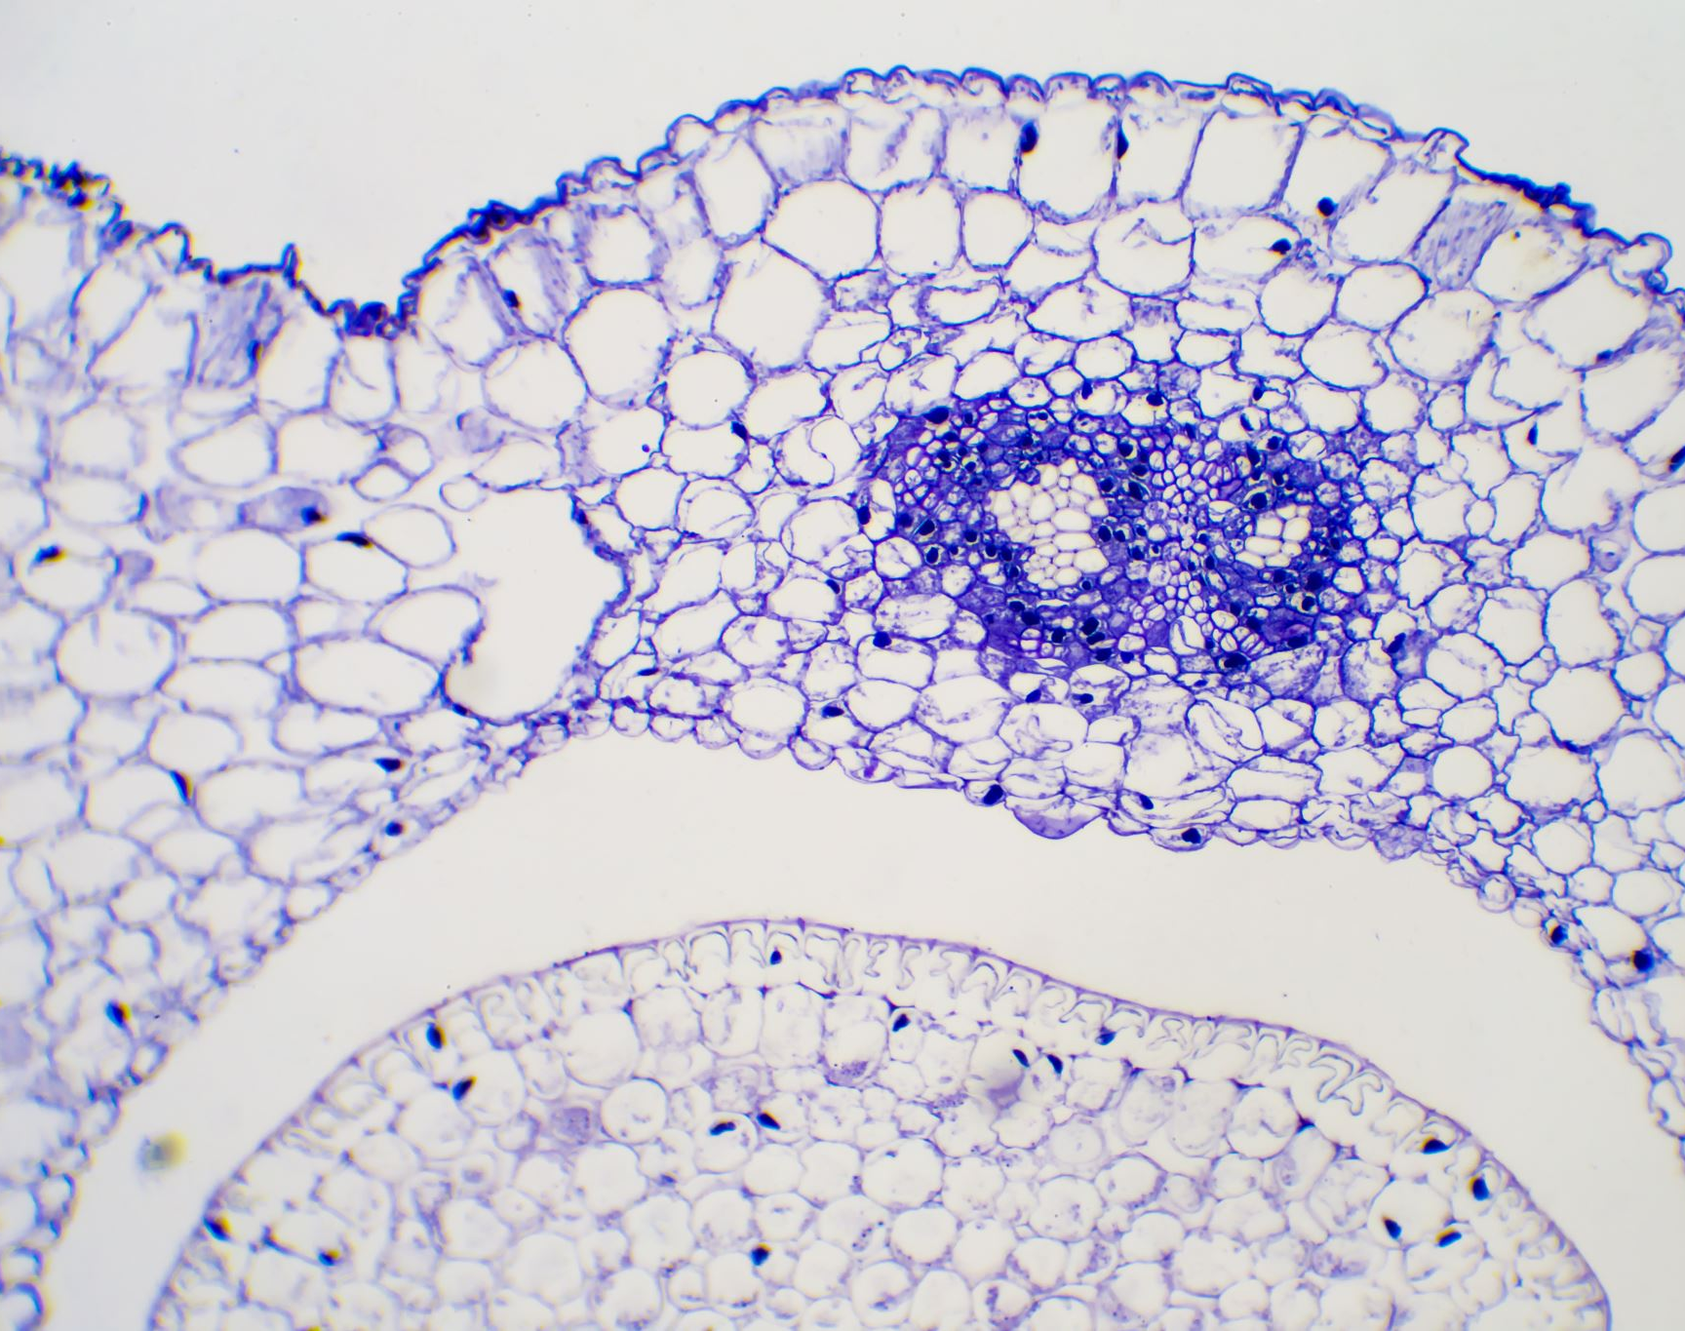
Bone marrow tests

Slide 35
Bone marrow testing – why?
Myeloma starts in the bone marrow
Only way to examine the myeloma cells in depth and assess their properties – how many? What do they look like? What are their genetics? How fast are they growing? Are they all gone after treatment?
Consists of an aspirate (liquid) and core biopsy (solid) sample from the bone marrow
Performed at diagnosis and then at provider’s discretion (often done after stem cell transplant and to determine if there has been a complete response).
Notes:
Bone marrow is both solid and liquid.
Solid – sponge-like structure consisting of a fibrous network filled with liquid
Liquid – contains blood-making (hematopoietic) stem cells, blood cells in various states of maturation as well as iron, folate, and B12 that are used to produce blood cells

Slide 36
Bone marrow aspirate (Plasma cell percentage)
Measured in both the aspirate and core biopsy
Normal bone marrow has about 2% plasma cells or fewer
>60% plasma cells is an independent myeloma defining event (MDE)
Not distributed evenly throughout the marrow, but the iliac crest is highly active bone marrow in adults and provides a fairly representative sample of how the myeloma is behaving in the marrow and how many cells are being pushed into the blood stream.

Slide 37
Immunohistochemistry (IHC) of plasma cells
Also known as immunophenotyping
Important tool for diagnosis and prognosis in myeloma
Detects antigens in tissue samples by introducing antibodies that would bind to them.
One of the tests used to determine stringent complete response (sCR) after treatment
Identifies myeloma protein markers, if they are present
Uses antibodies that are marked with a fluorescent marker that is then sorted by a laser-based instrument to identify and sort myeloma cells. (Flow cytometry)

Slide 38
Cytogenetics (karyotyping)
Assessment of the chromosomes in dividing myeloma cells
There are usually very few myeloma cells that are actively dividing so when an abnormality is found it’s important to note
Routinely performed on the bone marrow in newly diagnosed myeloma and sometimes repeated (often after stem cell transplant) to evaluate if the abnormalities have been “cleared”.
At relapse, can be done to evaluate for new abnormalities.
Particularly helpful in identifying a higher-than-average-risk in patients with fewer than two copies of each chromosome (hypodiploidy) and in those with a deleted 13th chromosome (deletion 13).

Slide 39
FISH (Fluorescence in situ hybridization)
Newer test than standard cytogenetics
Used in addition to karyotyping to get more information about the myeloma cells
Assessment of all the chromosomes of all the myeloma cells in a bone marrow sample (not just actively dividing cells).
Allows detection of changes whether myeloma cells are growing or not
Can detect both numerical and structural abnormalities

Slide 40
FISH
Provides a way to visualize and map genetic material in an individual’s cells, including specific genes or portions of genes.
Not performed on cells that are actively dividing.
Capable of detecting chromosomal translocations (when one piece of a chromosome is shifted over the another chromosome during cell division) – they “trade places”.
Results have been incorporated in the R-ISS because they are a powerful tool for predicting risk and survival in myeloma.

Slide 41
High risk abnormalities by FISH
t(4;14) – translocation of the gene segments on chromosomes 4 and 14.
t(14;16) – translocation of gene segments on chromosomes 14 and 16.
t(14;20) – translocation of gene segments on chromosomes 14 and 20.
17p-: deletion of 17p (the short arm of chromosome 17 is deleted); high risk (p53, an important tumor suppressor gene is located in that area)
Notes:
Tumor suppressor genes (known as the anti-oncogene) help control cell division and prevent cancer cells from developing and multiplying.

Slide 42
Other abnormalities by FISH
Nearly all myeloma patients have deletion of all or part of chromosome 13 (del13) so this is not a reliable indicator of risk.
There are some changes that can help guide therapy choices:
t(4;14) often responds to regimens that contain Velcade for induction and maintenance therapy.
Pomalyst is less effective if there is a t(4;14)
Pomalyst could be more effective in treatment when 17p- is present (may be able to overcome some of the negative impact).
t(11;14) often responds to Venetoclax.

Slide 43
FISH abnormalities - summary
Evaluation for del(13), del(17p13), t(4;14), t(11;14), t(14;16), t(14;20), 1q21 amplification/gain, and 1p deletion.
Deletion 17p13 is considered a higher-risk feature of MM.
There are several studies that show higher-risk including t(4;14), t(14;16), t(14;20)
t(11;14) is believed to be lower risk (and often responds to venetoclax).
Chromosome 1 abnormalities are the most common in MM; 1q21 increases the risk of progression and it’s incidence is higher in relapsed disease.
These are all used for risk stratification, selection, counseling, some selection of therapy, and clinical trial eligibility.

Slide 44
Mayo Clinic Risk Stratification for MM (mSMART)
Standard-risk | Trisomy of any genes, t(11;14) and t(6;14).
 | 75% of newly diagnosed patients.
High‐risk | Del(17p), t(4;14), t(14;16), t(14;20), Gain 1q, p53 mutation, R-ISS Stage III, High-risk signature by GEP, or High Plasma Cell S-phase.
 | 25% of newly diagnosed patients.
 | The presence of any two high-risk genetic abnormalities is considered double‐hit myeloma; three or more high-risk ganetic abnormalities are triple‐hit myeloma.
Genetic abnormalities by FISH or equivalent method Trisomies may ameliorate the risk t(11;14) may be associated with plasma cell leukemia
Notes:
HealthTree has a great explanation of this by Dr. Gertz from Mayo Clinic.

Slide 45
Next generation flow cytometry (NGF for MRD)
Black Swan Research Initiative ® (BSRI ®).
Uses antibodies and newly designed myeloma-specific software to rapidly perform more sophisticated immunophenotyping of myeloma cells.
Highly accurate way to detect minimal residual disease (MRD) after treatment
Sensitive enough to identify 1 myeloma cell in approximately 1,000,000 bone marrow cells sampled.
Not standard of care yet although being used more frequently and in almost all clinical trials – still being tested more widely for ideal use in all patients.

Slide 46
MRD (some caveats)
NCCN recommends baseline identification or storage of a sample of bone marrow aspirate for future identification by MRD testing if required at relapse.
Important predictor of depth of response.
There is data to use MRD to de-escalate/escalate treatment and or decide duration or maintenance therapy.
Lack of testing uniformity and guidelines for applicability and standard use in practice has limited the application in clinical practice outside of trials. Tertiary centers are moving toward MRD in all, but are not there yet for all patients.

Slide 47
Next generation sequencing…best practice?
Single nucleotide polymorphism (SNP) and/or next generation sequencing (NGS) panels on bone marrow provide more detailed information of MM genetics.
Further risk categorization with identification of additional abnormalities that MAY be helpful for prognosis/therapeutic value.
NCCN includes these in certain circumstances, but not for all patients.

Slide 48
Next generation sequencing
Can detect more abnormalities in cells that might help “tailor” therapy
To be used with other methods of testing at this time.
More helpful at progression of disease than at diagnosis (still being investigated further – similar to MRD)

Slide 49
More Information…
HealthTree Foundation – Multiple Myeloma
Even more in depth lab information: https://healthtree.org/myeloma/community/resources
Understanding FISH, Genomics, and Myeloma Genetics
January 18, 2024 1 – 2pm EST
https://healthtree.org/myeloma/community/events/jan2024-newly-diagnosed-myeloma-patients

Slide 50
Questions?
Contact information:
erbcolleen@gmail.com
I can’t answer individual treatment questions; but would be happy to answer general questions about labs or other myeloma general questions.

