Slide 1
Minimal Residual Disease (MRD) in Multiple Myeloma
Sundar Jagannath, MD
Professor of Medicine
Icahn School of Medicine at Mount Sinai
Tisch Cancer Institute
New York, NY

Slide 2
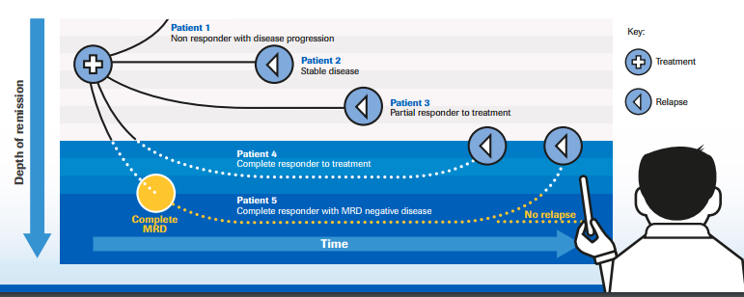
Why is MRD important to multiple myeloma patients?
CONCEPT: Eradication of tumor cells is necessary for a cure in most cancers
Therefore, detection of minimal residual cancer cells still present is important
EXCEPTION. (MGUS-like profile). A small number of residual tumour cells may persist under control of immune system for a long time (MM & low grade NHL)

Slide 3
What is MRD & depth of MRD?
Minimal Residual Disease (MRD) is the small amount of cancer cells that still remain in the body after treatment
Tumor cells
10⁹
10⁸
1 in 1,000 | CR
1 in 10,000 | SCR
1 in 100,000 | MRD by Flow Cytometry
1 in 1,000,000 | MRD by DNA Fingerprinting CyTOF
10⁷
10⁶
10⁵
- Flow
- NGS
10⁴
10³
10²
10¹
10
(Operational cure)
0
Time to progression
Each testing method has its own limitations!

Slide 4
Definitions for Depth of Response and MRD status
Complete Remission (CR) – 1 cancer cell in 1,000
No monoclonal protein (M-Spike) in serum or urine electrophoresis
Serum and Urine IFE is negative – no monoclonal band detected
Bone marrow biopsy has <5% plasma cells, not monoclonal
Stringent Complete Remission (sCR) – 1 cancer cell in 10,000
+ kappa/Lambda light chain ratio normal
Next generation Flowcytometry (MRD negative by NGF) – 1 in 100,000
Bone marrow aspirate, evaluate >5 million cells to detect monoclonal plasma cells using antibodies that can distinguish tumor plasma cells from normal bone marrow cells
Next Generation DNA Sequencing (MRD negative by NGS) – 1 in 1,000,000
Bone marrow aspirate, need >1 million cells to detect tumor plasma cells by DNA finger print technique
Liquid Tumor biopsy
Peripheral blood cells, to detect circulating tumor plasma cells by DNA finger print
Plasma, to detect circulating pieces of unique tumor cell DNA (Cell Free DNA)

Slide 5
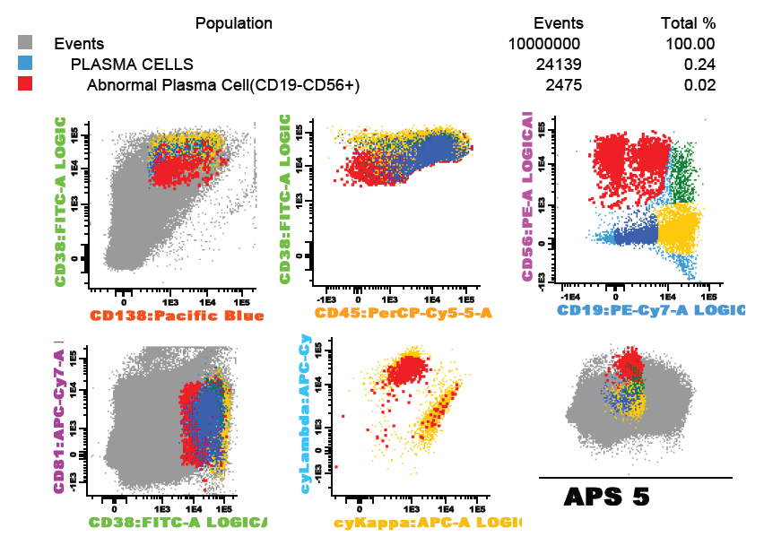
MRD testing by flow cytometry

Slide 6
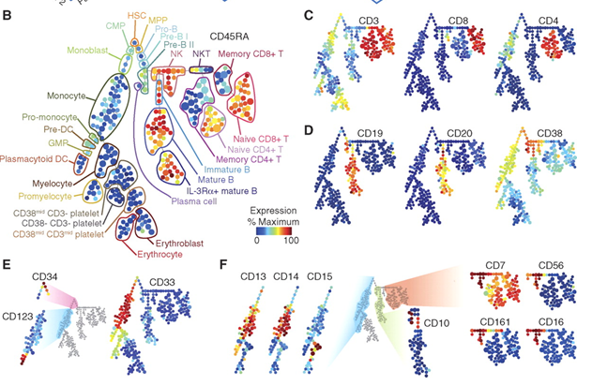
MRD testing by Mass Cytometry (CyTOF)
FACS uses fluorophores as labels of antibodies
FACS is limited to 10 colors because of spectral overlap
CyTOF substitutes isotopes of elements as labels for antibodies
Cells are vaporized and isotopes are analyzed by Time Of Flight mass spectrometer
Accurately measure 34 markers simultaneously on every cell that is analyzed; up to 100 may be possible
13 cell surface Ag
18 additional intracellular parameters
Sean C. Bendall et al. Science 2011;332:687-696

Slide 7
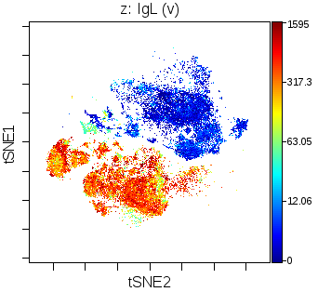
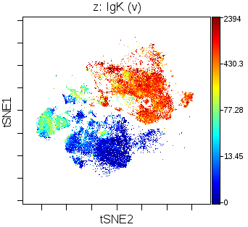
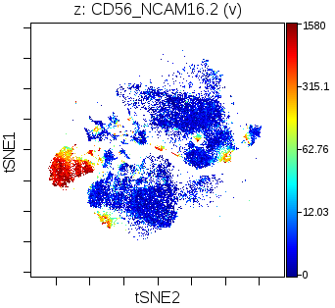
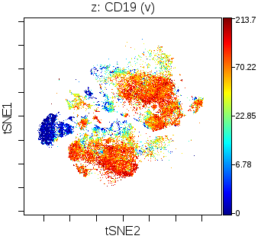
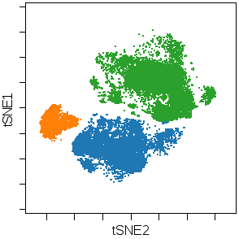
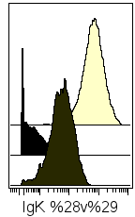
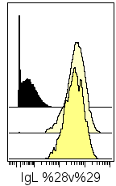
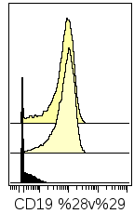
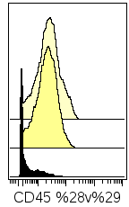
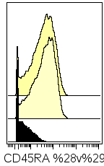
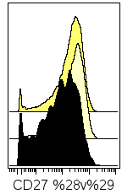
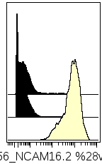
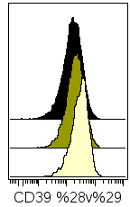
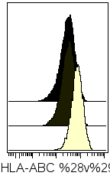
MRD testing by Mass Cytometry (CyTOF)
Total plasma cells
 | Count | % of total | % of PC
Total singlet events | 753779 | 100.00
Normal IgK PC | 14154 | 1.88 | 48.36
Normal IgL PC | 11489 | 1.52 | 39.26
Abnormal PC | 3623 | 0.48 | 12.38
IgK
IgL
CD19
CD45
CD45RA
CD27
CD56
CD39
HLA-ABC
Mass Cytometry (CyTOF)

Slide 8
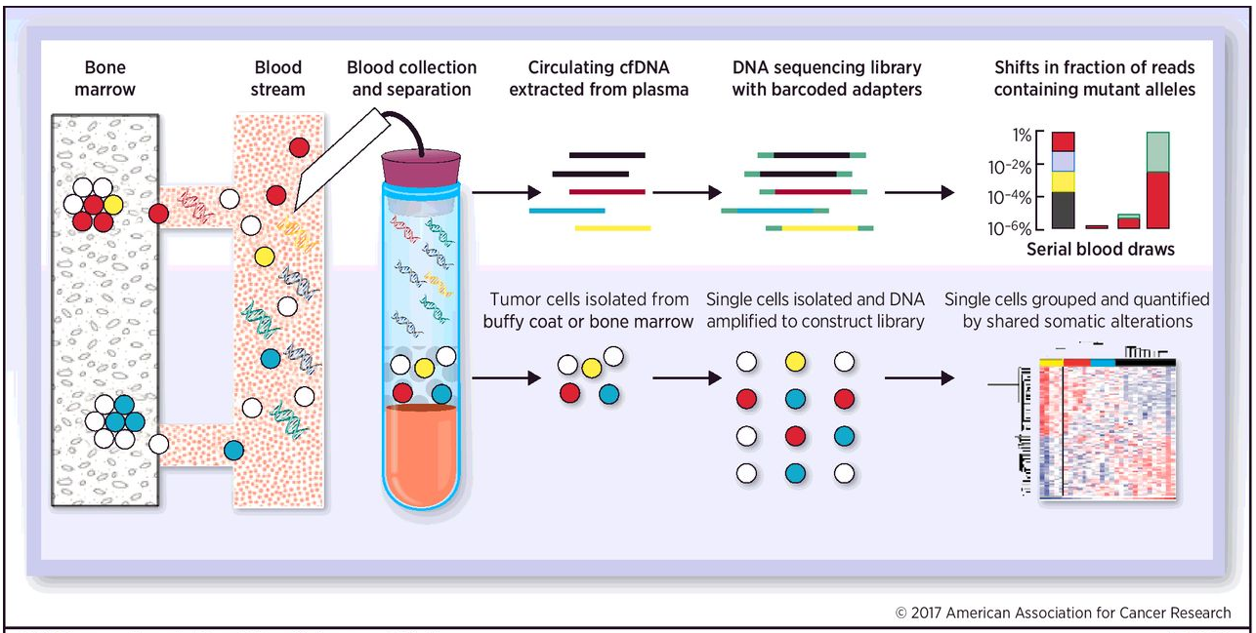
Future of MRD testing
Non-invasive testing – deep analysis of peripheral blood and bone marrow
Anderson et al Clin Cancer Res; 23(15) 3980-3993

Slide 9
Why is MRD important to multiple myeloma patients?
CONCEPT: Eradication of tumor cells is necessary for a cure in most cancers
Therefore, detection of minimal residual cancer cells still present is important
EXCEPTION. (MGUS-like profile). A small number of residual tumour cells may persist under control of immune system for a long time (MM & low grade NHL)

Slide 10
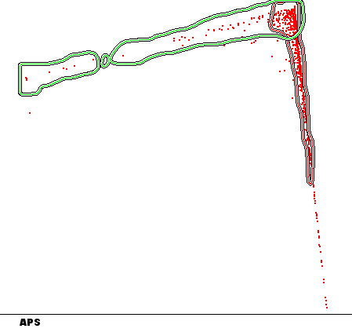
MGUS-like signature for identification of non-responding non-relapsing active MM patients
TTP
100
80
Median: NR
59% at 10y
60
Median: 44 months
14% at 10y
MM-like profile
(N = 639)
40
MGUS-like profile
(N = 59)
20
0
HR: 3.27 ; P < 10⁻⁶
Principal component analysis
0
20
40
60
80
100
120
140
Time from diagnosis (months)
MGUS-like profile (n=59) MM-like profile (n=639)
Paiva B, et al. Leukemia. 2013;27(10):2056-2061.

Slide 11
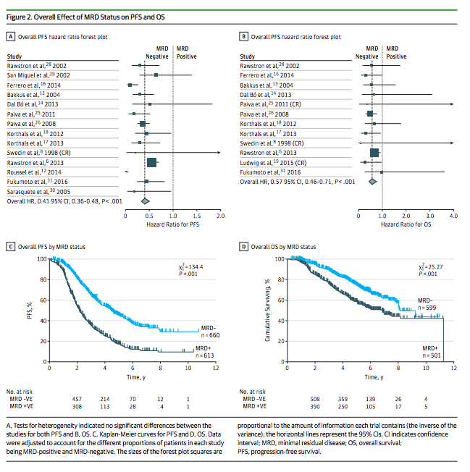
MRD signifies longer duration of remission
Munshi et al. JAMA Oncol. 2017;3(1):28-35

Slide 12
IMWG criteria for MRD in multiple myeloma
Response subcategory |  | Response criteria
IMWG MRD negativity criteria (Requires CR as defined below) | Sustained MRD-negative | MRD negative in the marrow (next-generation flow or next-generation sequencing) and by imaging as defined below, confirmed one year apart. Subsequent evaluations can be used to further specify the duration of negativity (e.g., MRD negative at 5 years)
 | Imaging-positive MRD-negative | MRD negativity as defined by next-generation flow or next-generation sequencing PLUS disappearance of every area of increased tracer uptake found at baseline or a preceding PET/CT OR decrease to less mediastinal blood pool SUV or decrease to less than that of surrounding normal tissue
 | Flow MRD-negative | Absence of phenotypically aberrant clonal plasma cells by next-generation flow cytometry on bone marrow aspirates using the EuroFlow standard operation procedure for MRD detection in MM (or validated equivalent method) with a minimum sensitivity of 1 in 10⁵ nucleated cells or higher
 | Sequencing MRD negative | Absence of clonal plasma cells by next generation sequencing on bone marrow aspirates in which presence of a clone is defined as less than 2 identical sequencing reads obtained after DNA sequencing of bone marrow aspirates using the LymphoSIGHT® platform (or validated equivalent method) with a minimum sensitivity of 1 in 10⁵ nucleated cells or higher
CR defined as negative immunofixation on the serum and urine and disappearance of any soft tissue plasmacytomas and <5% plasma cells in bone marrow aspirates
Kumar SK, et al. Lancet Oncol 2016; 17: e328–46.

